Slide 1


Slide 2
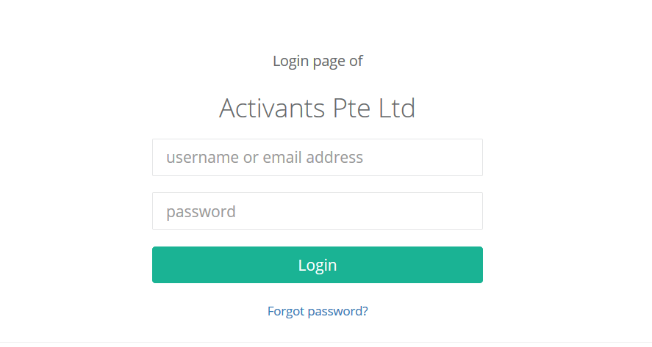

Slide 3
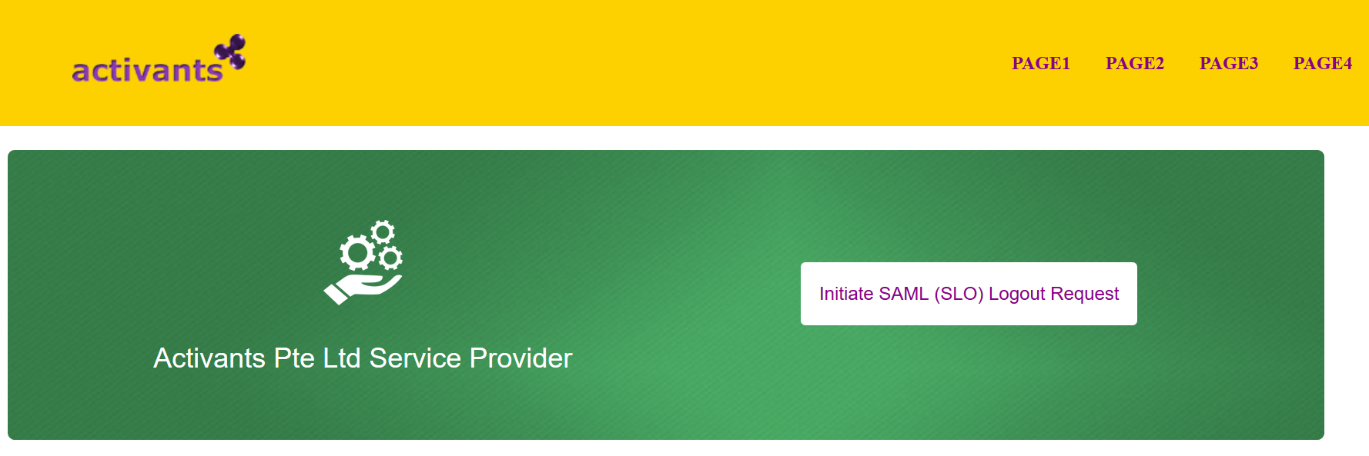

Slide 4
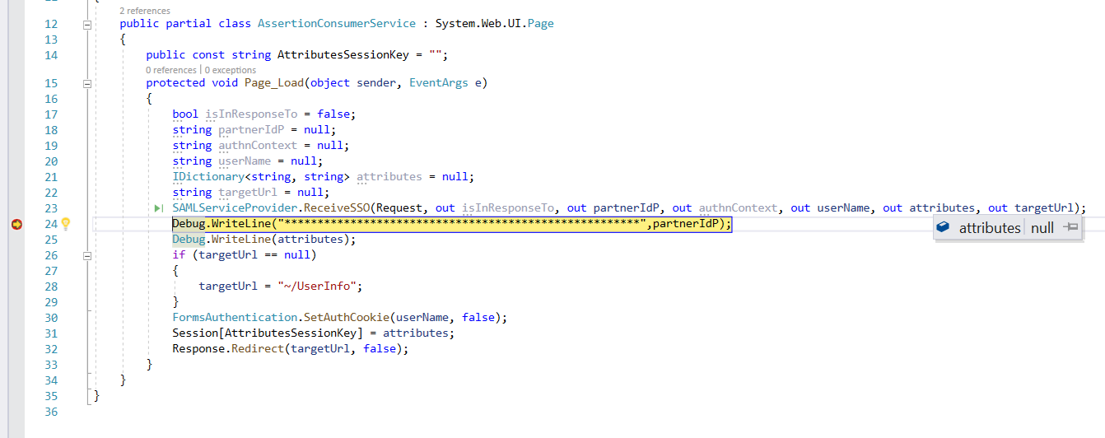
Why attributes parameter is null ? ? ? How to get them??
Answer: The attributes output parameter returns any SAML attributes that were included in the SAML assertion.
It’s null because the IdP didn’t include any. If you require specific attributes you need to contact the IdP.

Slide 5
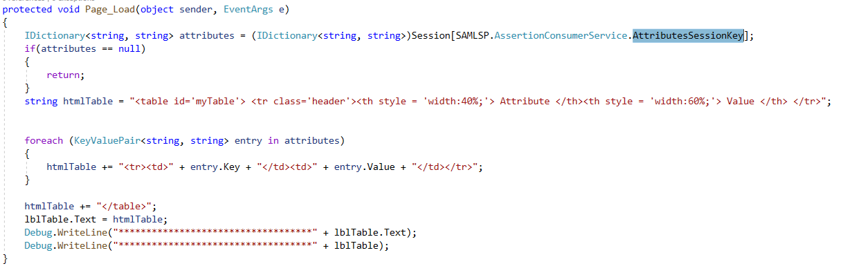
This is also NULL.. Suggest if changes are required..
Answer: These are the SAMl attributes from the SAML assertion. Please see my previous answer.

